Slide 1
Friends of Saintbridge Pond Annual General Meeting 2016
2015: A Year In Review

Slide 2
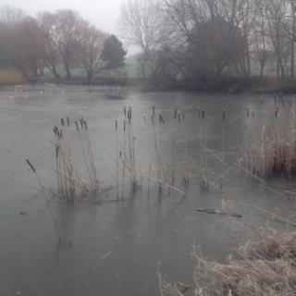
January
Planning AGM and Future Work

Slide 3
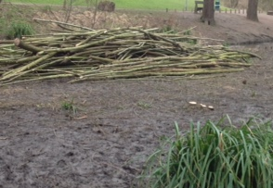
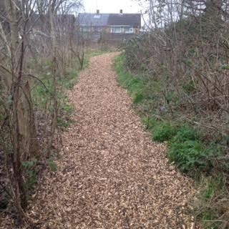
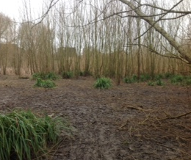
February
Willow Pollarding
GL4 Meetings Start
Woodchip spread along Woodland Path
FOSP AGM

Slide 4
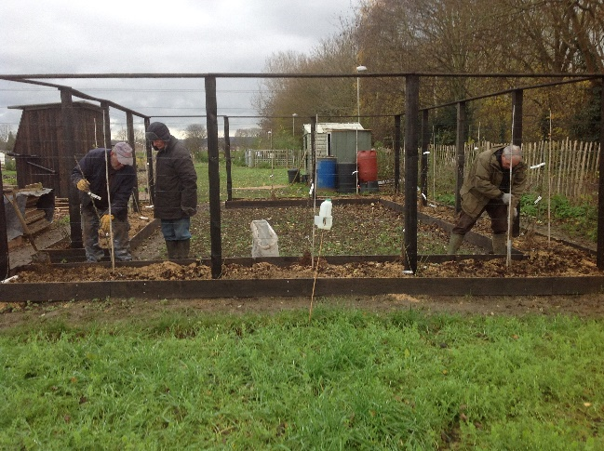
March
Work on Community Gardens started
Grace Bowles donated trees in memory of Husband George
Draft Development Plan of Future Work (Green Flag)

Slide 5
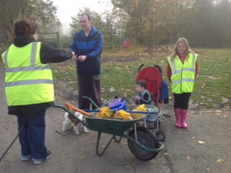
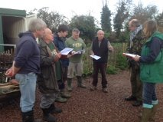
April
Induction and Health & Safety Meetings
Wildflower Seeds planted
New Volunteers:
Michelle Molly Jackie
Meeting with Friends Network at Gloucester Academy

Slide 6
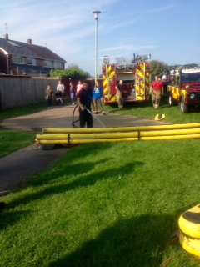
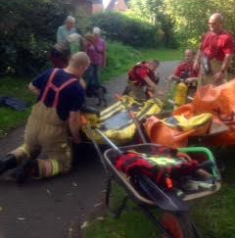
May
The Aston Project and Fire & Rescue start work on Large Island
SAGA AGM

Slide 7
June
The Green Flag Feedback

Slide 8
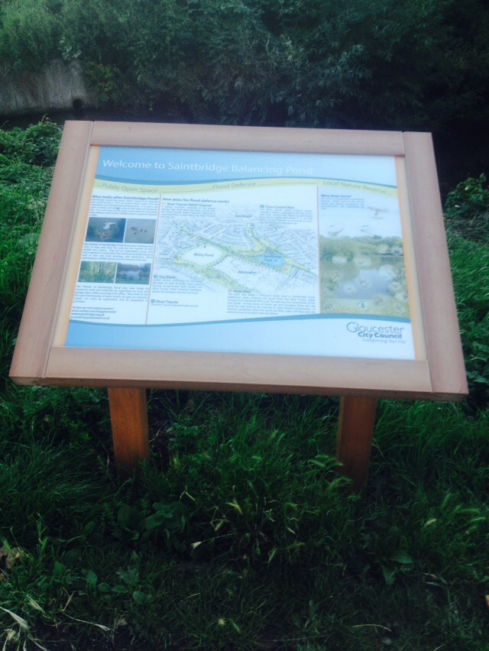
July
Interpretation Board Erected
Social Media Team formed, Facebook created, Twitter Competitions discussed

Slide 9
August
FOSP Logo Agreed
Banner Designed, Agreed and Printed

Slide 10
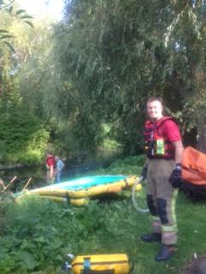
September
Aston Project and Fire & Rescue continue work on Large Island
GL4 Together Show Day
New Bench at Feeding Area, with Social Media coverage.

Slide 11
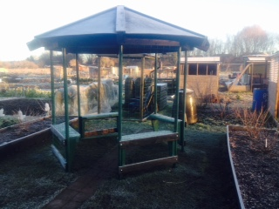
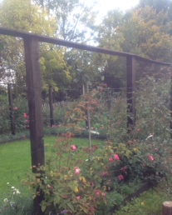
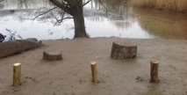
October
Vegetation Scything on Perimeter Banks
Three new volunteers under 16 which prompted research
New Duck Ramp
Draft Map of Bulb Planting Created
Painted four wooden posts around the pond
Community Gardens work and plans drafted

Slide 12
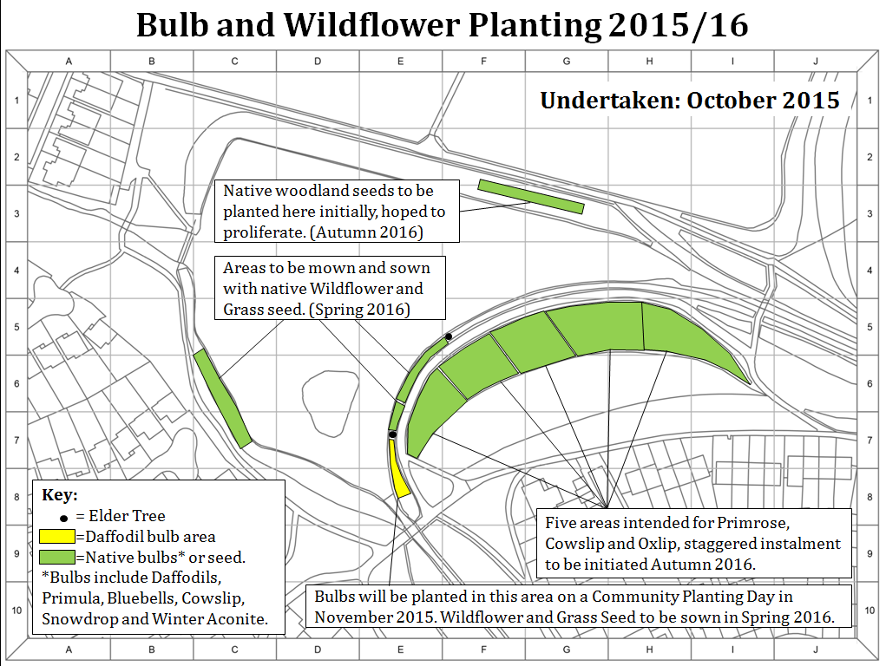

Slide 13
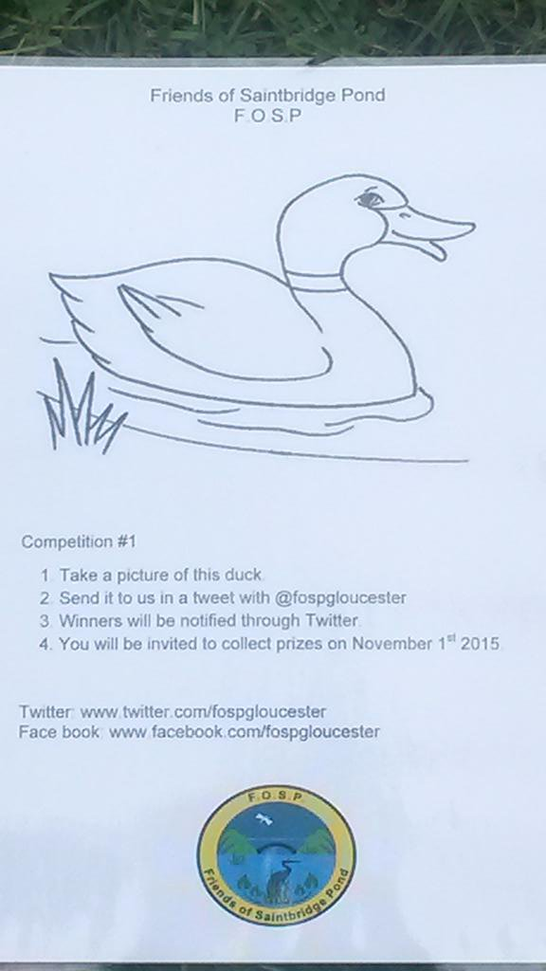
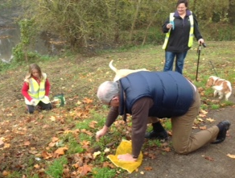
November
FOSP Environment Agency work along the Silt Trap
Community Bulb Planting Day; 2000 bulbs planted
New Volunteer:
Gabriel
John Clarke researched insurance cover
Competitions Launched, Social Media promoting

Slide 14
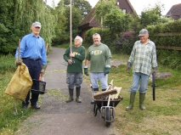
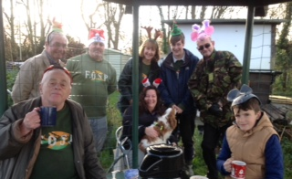
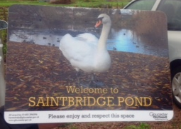
December
Thinning of Saplings in the Woodland Area
Erection of new signs

Slide 15
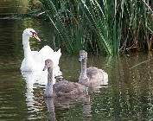
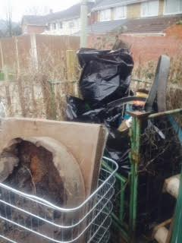
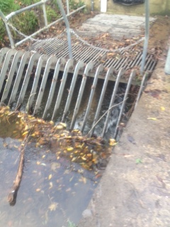
Highlights 2015
Continuously cleared silt traps and collected litter
Partnerships formed between Aston Project and Gloucester Academy
The woodland path has made great progress, with a wood chipped path and reduced Willows.
Social media going well, with recent posts from a great social media team and currently at 66 followers on Twitter and 30 likes on Facebook
Mapping for green flag undertaken, including bulb planning, some of which has already been carried out
Information boards and signs have been put up
Community gardens completed, looking beautiful
Swans successfully reared 1 cygnet in 2015
Complete rebranding, including working poster
7 new volunteers, 4 of which have stayed. A substantial growth.

Slide 16
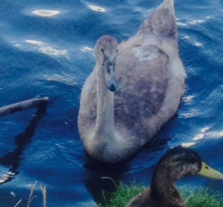
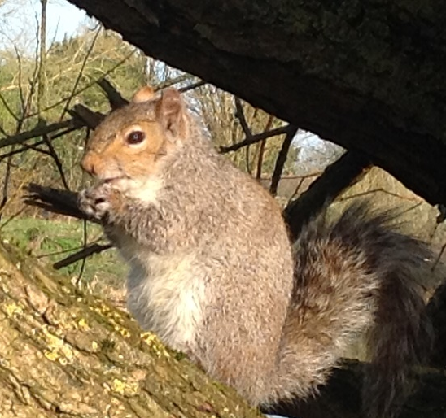
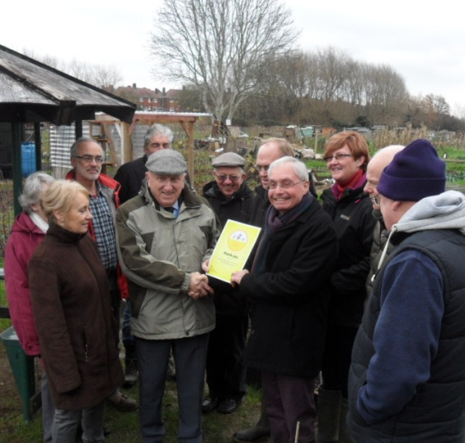
So far in 2016...
January 2016
Overview of the work to be done at the pond
Clearance of Bramble at Cheyney Close
Keeping the Silt Traps clear
Bees Needs Award Presentation for providing pollinator resources for bees
Several Walkabouts and Meetings with Amey and Gloucester City Council

